Slide 1
Nuclear Fuel Performance
NE 533: Spring 2023

Slide 2
heat transport

Slide 3
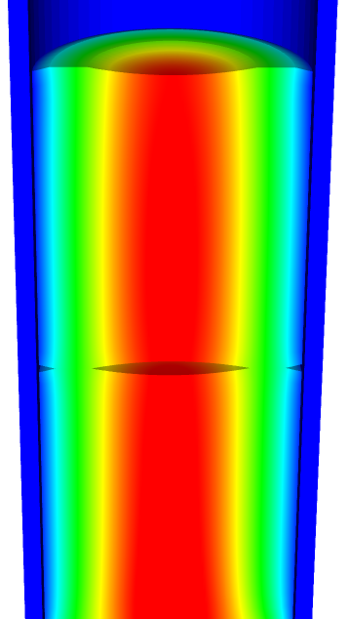
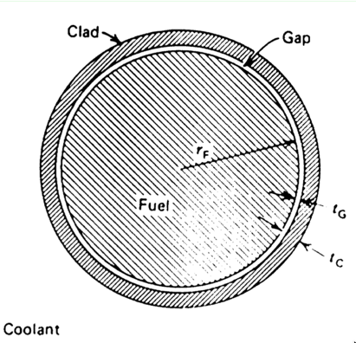
Heat transport route
Heat is produced in the fuel, transports through the cladding and gap, and into the coolant
Important quantities include
Volumetric heat generation rate Q (W/cm³)
Fuel Centerline temperature T₀
Surface temperature of the fuel T_{F}
Inner cladding temperature T_{CI}
Outer cladding temperature T_{CO}
Coolant temperature T_{cool}
Fuel pellet radius r_{F}
Gap thickness t_{G}
Cladding thickness t_{c}

Slide 4
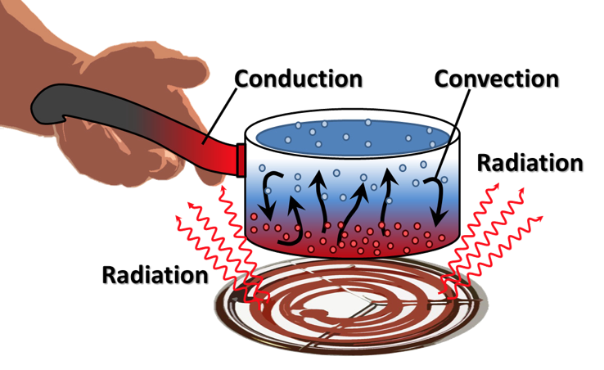
Heat can be transported in three ways
Convection
Heat transfer through mass movement of liquid or gas
Radiation
Heat transfer by means of photons in electromagnetic waves
Conduction
Heat transfer by molecular or atomic motion

Slide 5
Heat transfer mode in fuel systems?
How is heat transported through the fuel?
Conduction
How is the heat transported through the gap?
Mostly conduction, some convection
How is heat transported through the cladding?
Conduction
How is heat transported to the coolant?
Convection

Slide 6
Heat conduction equation
ρ is the density, c_{p} is the specific heat, T is the temperature, t is the time, and k is the thermal conductivity
It is a partial differential equation in time and space
We are solving for the T as a function of space and time
T(x, t), where x is a vector defining the position in space
What do we need to know to solve this equation?
The geometry of our problem
The initial condition of T
The boundary conditions of T
Is each parameter is a function of T
If they aren’t a function of T, do they vary in space and time for some other reason?

Slide 7
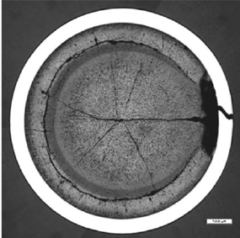
What is our geometry for the problem?
Reactor geometry depends on reactor type
The ideal geometry of each fuel rod is axisymmetric, but in reality it is 3D
Fuel pellet defects cause 3D geometry
The stacked pellets may not be stacked perfectly, causing their center axis to not be aligned, also causing 3D geometry

Slide 8
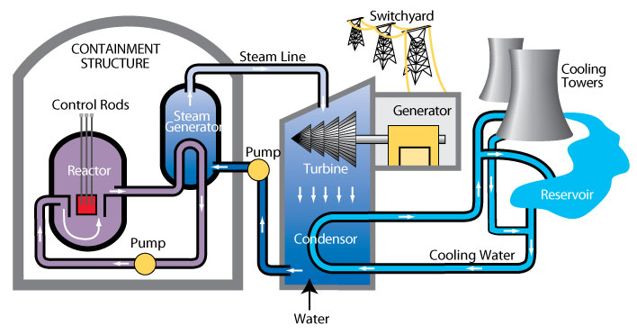
The initial condition of T
The initial condition of T is set by the state of the reactor directly before startup
What is the initial temperature profile of the fuel?
The initial temperature is uniform throughout the fuel
It is equal to the initial coolant temperature
T(x, 0) = T_{cool}(0)

Slide 9
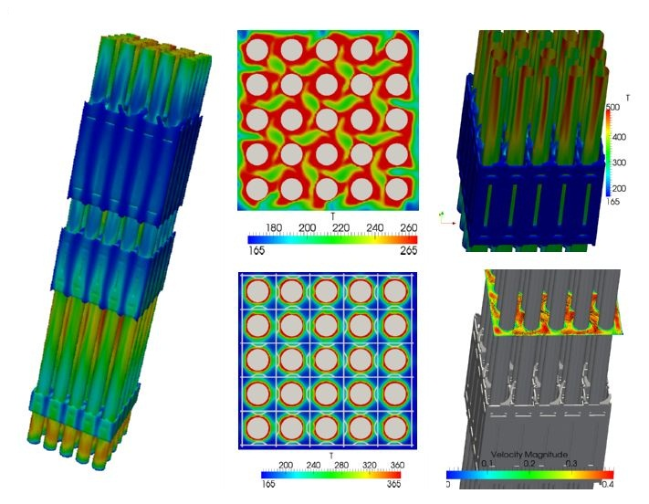
Boundary conditions?
The boundary conditions on T is set by the coolant flow
The temperature of the coolant T_{cool} is complicated
It varies along the length of the fuel rod (axially)
It various around the circumference of the fuel rod

Slide 10
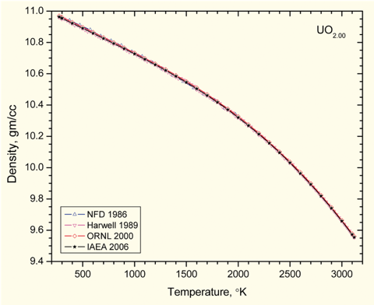
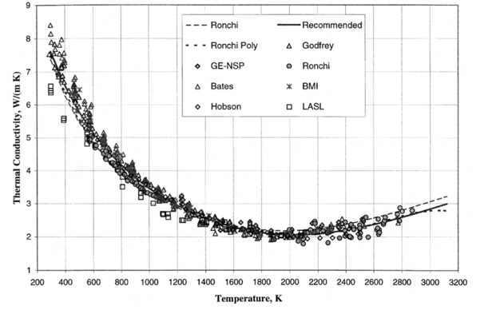
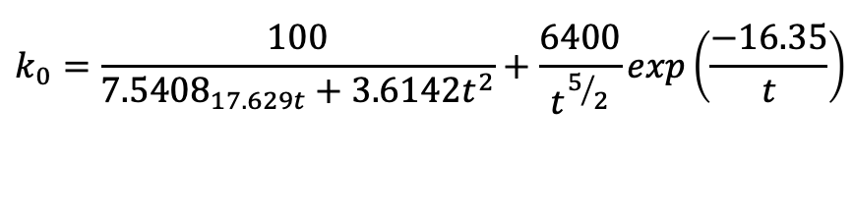
Fuel properties
Density varies as a function of T (thermal expansion)
Also varies as a function of composition (thus as a function of burnup/time)
Thermal conductivity also varies with temperature
$$k_{0}=\frac{100}{{7.5408}_{17.629t}+3.6142t^{2}}+\frac{6400}{t^{5/2}}exp\left(\frac{−16.35}{t}\right)$$

Slide 11
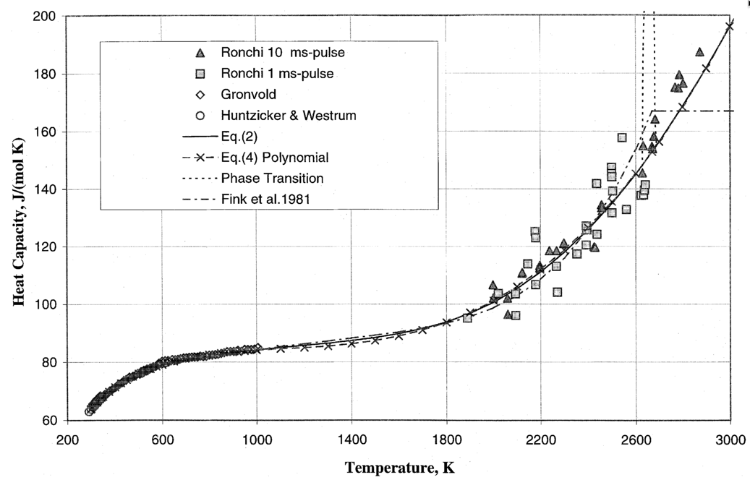
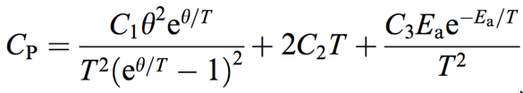
The heat capacity is a function of temperature
θ = 548.68,
C₂ = 2.285 × 10⁻³
C₃ = 2.360 × 10⁷
E_{a} = 18531.7

Slide 12
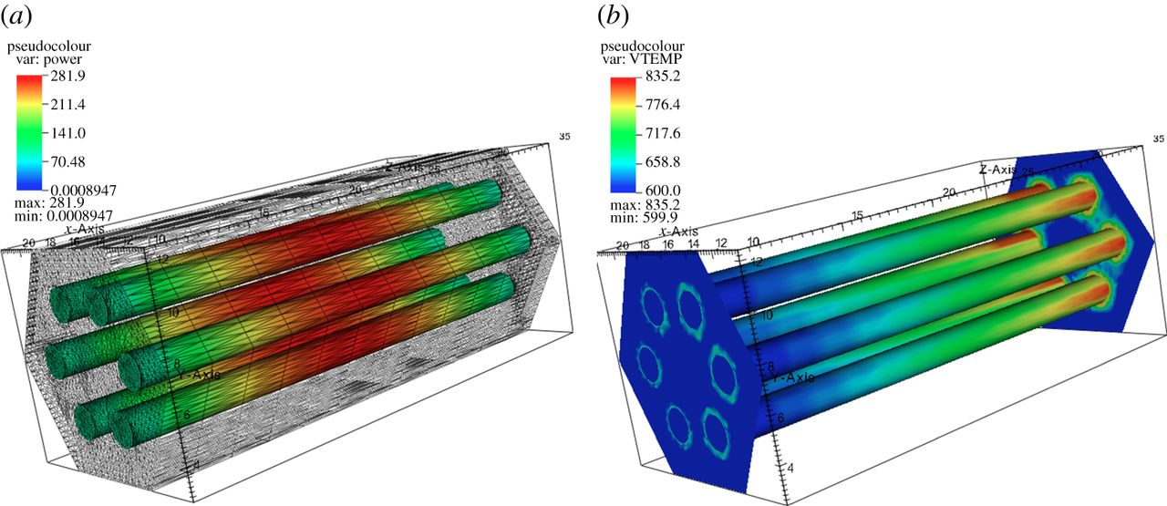
The heat generation rate is a function of the thermal neutron flux, which varies in time and space
Q = E_{f} N_{f} σ_{f} ϕ_{th}

Slide 13

Summary
General heat transport
Heat is produced in the fuel, transports through the cladding and gap, and into the coolant
The geometry of our problem
The initial condition of T
The boundary conditions of T
Is each parameter is a function of T
Thermal conductivity, heat capacity
Function of space/time?
Heat generation, dependent upon flux

Slide 14
Last Time
Mining -> Processing -> Conversion -> Enrichment -> Powder -> Compaction/Sintering -> Rod/Assembly
U₃O₈ must be converted to UF₆ for enrichment, which is then converted to UO₂ powder for pellet manufacture
For different fuel types, enriched UF₆ follows a different path

Slide 15

Last Time
General heat transport
Heat is produced in the fuel, transports through the gap and cladding, and into the coolant
The geometry of our problem
The initial condition of T
The boundary conditions of T
Is each parameter is a function of T
Thermal conductivity, heat capacity
Function of space/time?
Heat generation, dependent upon flux

Slide 16
Analytical solve of heat conduction

Slide 17
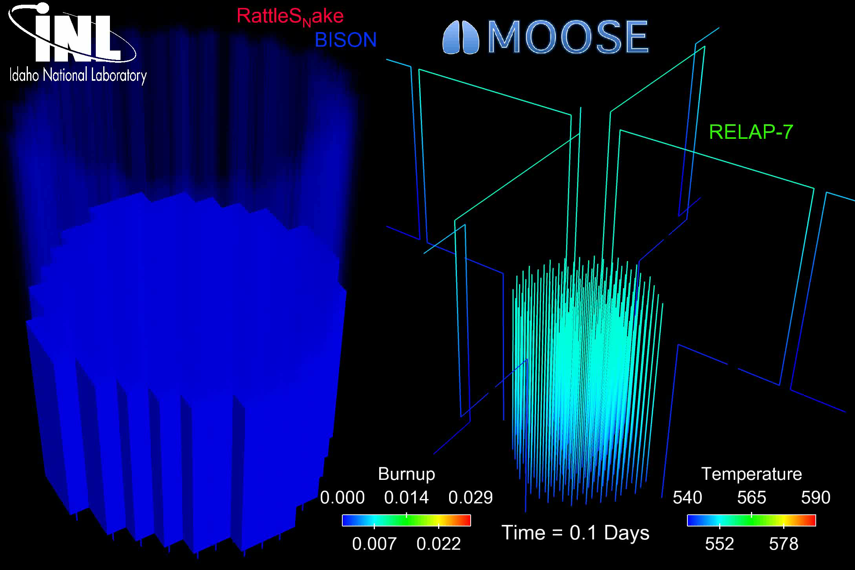
The most accurate solution is numerical, in 3D, requires modeling the entire core, and is multi-physics
Solution is 3D and changes in time
All the properties are functions of temperature
The boundary conditions comes from information about the coolant flow
The heat generation rate comes from information about the neutronics in the reactor
No analytical solution is possible

Slide 18

In order to solve, make assumptions!
#1: steady state ->
#2: axisymmetric ->
#3: constant in z
#4: constant thermal conductivity

Slide 19
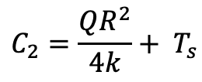
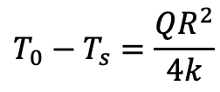
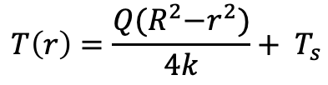
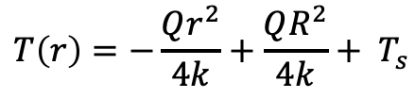
Directly Solving for Temperature Profile
Boundary conditions: r₀ = 0, r₁=R, T’(0) = 0, T(R) = T_{s}
r0
r1
$$C_{2}=\frac{QR^{2}}{4k}+ T_{s}$$
$$T\left(r\right)=−\frac{Qr^{2}}{4k}+\frac{QR^{2}}{4k}+ T_{s}$$
$$T\left(r\right)=\frac{Q{(R}^{2}−r^{2})}{4k}+ T_{s}$$
$$T_{0}−T_{s}=\frac{QR^{2}}{4k}$$

Slide 20
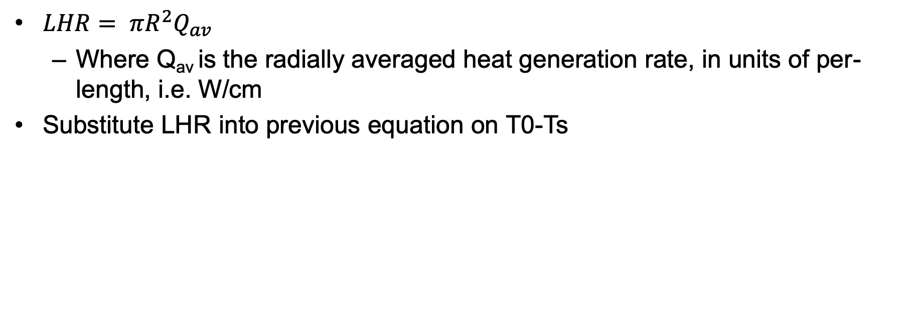
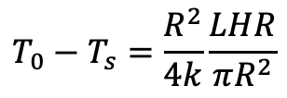
Linear Heat Rate
$LHR= πR^{2}Q_{av}$
Where Q_{av} is the radially averaged heat generation rate, in units of per-length, i.e. W/cm
Substitute LHR into previous equation on T0-Ts
$$T_{0}−T_{s}=\frac{R^{2}}{4k}\frac{LHR}{πR^{2}}$$

Slide 21
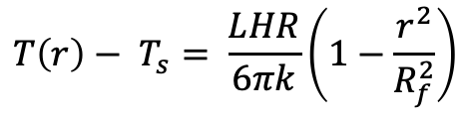
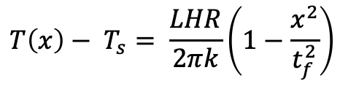
Alternate Geometries
Similar derivation with appropriate boundary conditions can be applied to plate and sphere geometries
Plate
Sphere
$$T\left(x\right)− T_{s}= \frac{LHR}{2πk}\left(1−\frac{x^{2}}{t_{f}^{2}}\right)$$
$$T\left(r\right)− T_{s}= \frac{LHR}{6πk}\left(1−\frac{r^{2}}{R_{f}^{2}}\right)$$
x is the distance from the midplane of the fuel and tf is the plate fuel thickness
r is the distance from the sphere center and Rf is the radius of the sphere

Slide 22
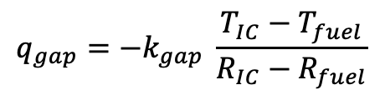
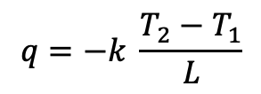
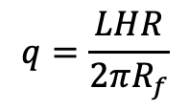
Heat transport through the gap
R₀=0
R₁=R_{f}
R₂=R_{IC}
The heat flux gives the rate, per unit area, at which heat flows in a given direction
The heat flux from the fuel is the LHR/pellet circumference
Heat flux from the fuel is the same as heat flux through the the gap – can make this assumption because R_{f} >> t_{g}
Gap thickness = R_{IC}-R_{f} = t_{g}
Cladding thickness = R_{OC}-R_{IC} = t_{c}
$$q=−k \frac{T_{2}−T_{1}}{L}$$
$$q_{gap}=−k_{gap} \frac{T_{IC}−T_{fuel}}{R_{IC}−R_{fuel}}$$
$$q=\frac{LHR}{2πR_{f}}$$
R₃=R_{OC}

Slide 23
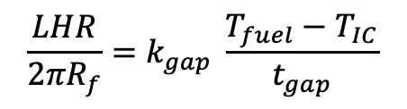
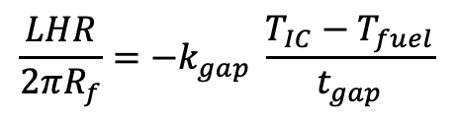
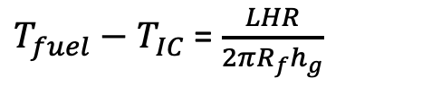
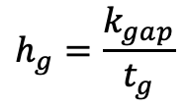
Heat transport through the gap
Set heat flux fuel/gap equal
Gap conductance is defined as:
Gap conductance depends on the gas filling the gap
For pure He, k_{gap}=16x10⁻⁶ * T^{0.79} (W/cm-K)
For pure Xe, k_{gap}=0.7x10⁻⁶ * T^{0.79} (W/cm-K)
Simple mixing rule: k_{gap} = k_{He}(1-y) + k_{Xe}y
Where y is the mole/atom fraction of Xe
$$\frac{LHR}{2πR_{f}}=−k_{gap} \frac{T_{IC}−T_{fuel}}{t_{gap}}$$
$$\frac{LHR}{2πR_{f}}=k_{gap} \frac{T_{fuel}−T_{IC}}{t_{gap}}$$
$$h_{g}=\frac{k_{gap}}{t_{g}}$$
$T_{fuel}−T_{IC}$ = $\frac{LHR}{2πR_{f}h_{g}}$

Slide 24
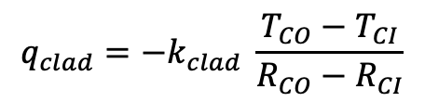
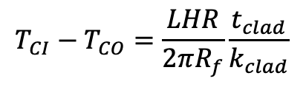
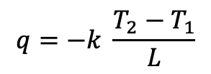
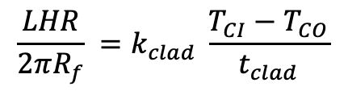
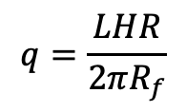
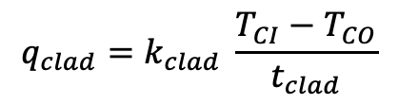
Heat transport through the cladding
$$q=−k \frac{T_{2}−T_{1}}{L}$$
$$q_{clad}=−k_{clad} \frac{T_{CO}−T_{CI}}{R_{CO}−R_{CI}}$$
Heat flux through the cladding
Set equal your heat fluxes
$$q=\frac{LHR}{2πR_{f}}$$
$$q_{clad}=k_{clad} \frac{T_{CI}−T_{CO}}{t_{clad}}$$
$$\frac{LHR}{2πR_{f}} =k_{clad} \frac{T_{CI}−T_{CO}}{t_{clad}}$$
$$T_{CI}−T_{CO}=\frac{LHR}{2πR_{f}}\frac{t_{clad}}{k_{clad}}$$

Slide 25
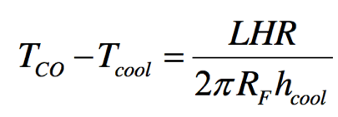
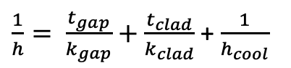
Heat transfer to the coolant
Heat is transported from the cladding to the coolant via convection
T_{cool} is the coolant temperature, h_{cool} is the convective heat transfer coefficient between cladding wall and coolant
Adding gap + cladding + coolant:
$\frac{1}{h}= \frac{t_{gap}}{k_{gap}}+$ $\frac{t_{clad}}{k_{clad}}$ + $\frac{1}{h_{cool}}$

Slide 26
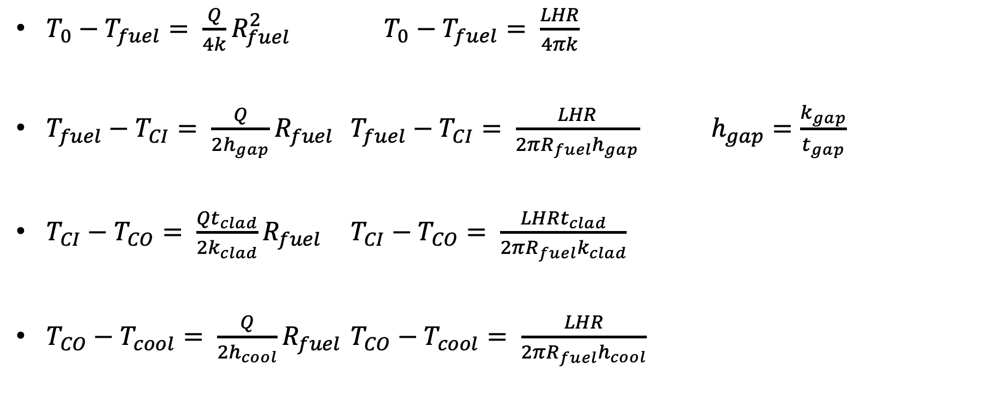
Summary of analytical solutions
$T_{0}−T_{fuel}= \frac{Q}{4k}R_{fuel}^{2}$ $T_{0}−T_{fuel}= \frac{LHR}{4πk}$
$T_{fuel}−T_{CI}= \frac{Q}{2h_{gap}}R_{fuel}$ $T_{fuel}−T_{CI}= \frac{LHR}{2{πR_{fuel}h}_{gap}}$ $h_{gap}=\frac{k_{gap}}{t_{gap}}$
$T_{CI}−T_{CO}= \frac{Qt_{clad}}{2k_{clad}}R_{fuel}$ $T_{CI}−T_{CO}= \frac{LHRt_{clad}}{2{πR_{fuel}k}_{clad}}$
$T_{CO}−T_{cool}= \frac{Q}{2h_{cool}}R_{fuel}$ $T_{CO}−T_{cool}= \frac{LHR}{2{πR_{fuel}h}_{cool}}$

Slide 27
Solving for the temperature profile
T_{CO} T_{CI}
You first solve for the transition temperatures.
Start from the coolant and work inward
Have a linear profile everywhere except in the fuel
Finally, solve for the temperature profile throughout the fuel
T_{cool}

Slide 28
Fuel and Cladding Thermal Properties
Material | Density (g/cm³) | Heat Capacity Cp (J/g-K) | Thermal Conductivity k (W/cm-K) | Thermal Expansion Coefficient a (K⁻¹)
UO₂ | 10.98 | 0.33 | 0.03 | 1.2 x 10⁻⁵
Zr | 6.5 | 0.35 | 0.17 | 1.0 x 10⁻⁵
Stainless steel | 8.0 | 0.5 | 0.17 | 9.6 x 10⁻⁶

Slide 29
Example Problem

Slide 30
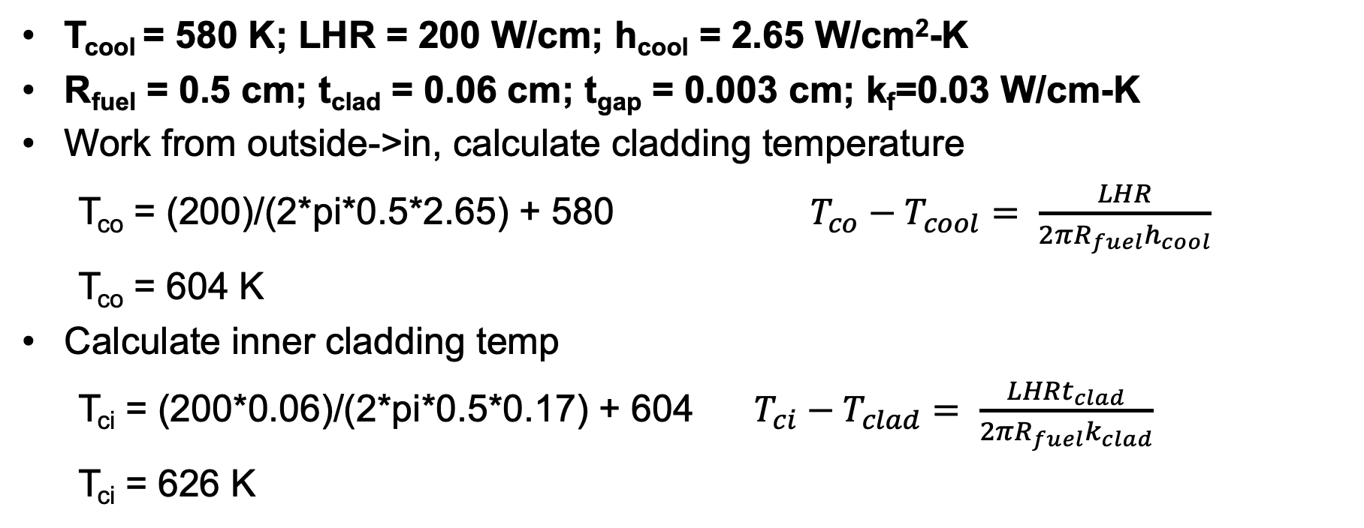
Temperature profile calculation example
T_{cool} = 580 K; LHR = 200 W/cm; h_{cool} = 2.65 W/cm²-K
R_{fuel} = 0.5 cm; t_{clad} = 0.06 cm; t_{gap} = 0.003 cm; k_{f}=0.03 W/cm-K
Work from outside->in, calculate cladding temperature
T_{co} = (200)/(2*pi*0.5*2.65) + 580 $T_{co}−T_{cool}= \frac{LHR}{2{πR_{fuel}h}_{cool}}$
T_{co} = 604 K
Calculate inner cladding temp
T_{ci} = (200*0.06)/(2*pi*0.5*0.17) + 604 $T_{ci}−T_{clad}= \frac{LHRt_{clad}}{2{πR_{fuel}k}_{clad}}$
T_{ci} = 626 K

Slide 31
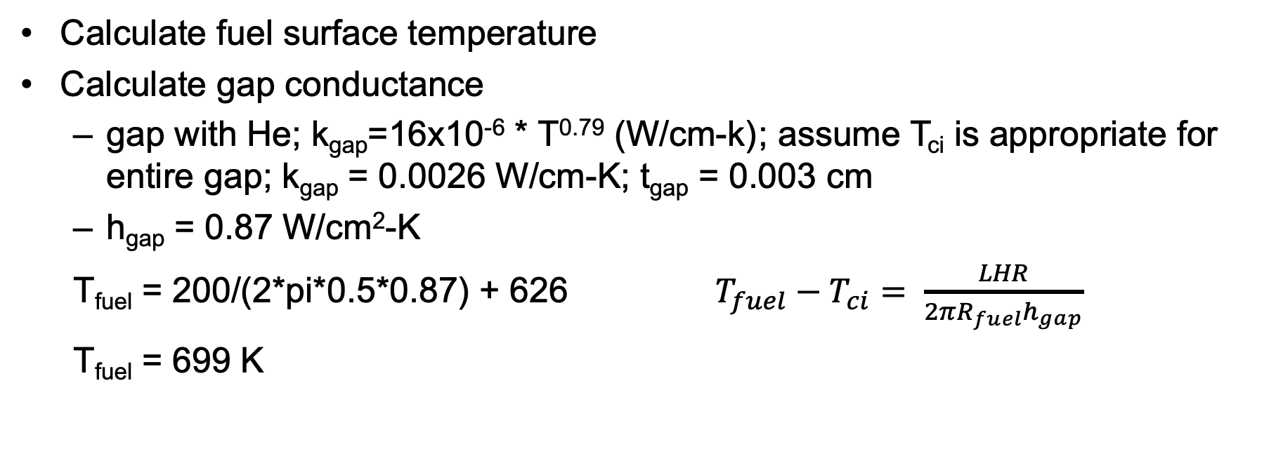
Temperature profile calculation example
Calculate fuel surface temperature
Calculate gap conductance
gap with He; k_{gap}=16x10⁻⁶ * T^{0.79} (W/cm-k) ; assume T_{ci} is appropriate for entire gap; k_{gap} = 0.0026 W/cm-K; t_{gap} = 0.003 cm
h_{gap} = 0.87 W/cm²-K
T_{fuel} = 200/(2*pi*0.5*0.87) + 626 $T_{fuel}−T_{ci}= \frac{LHR}{2{πR_{fuel}h}_{gap}}$
T_{fuel} = 699 K

Slide 32
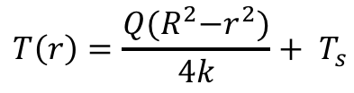
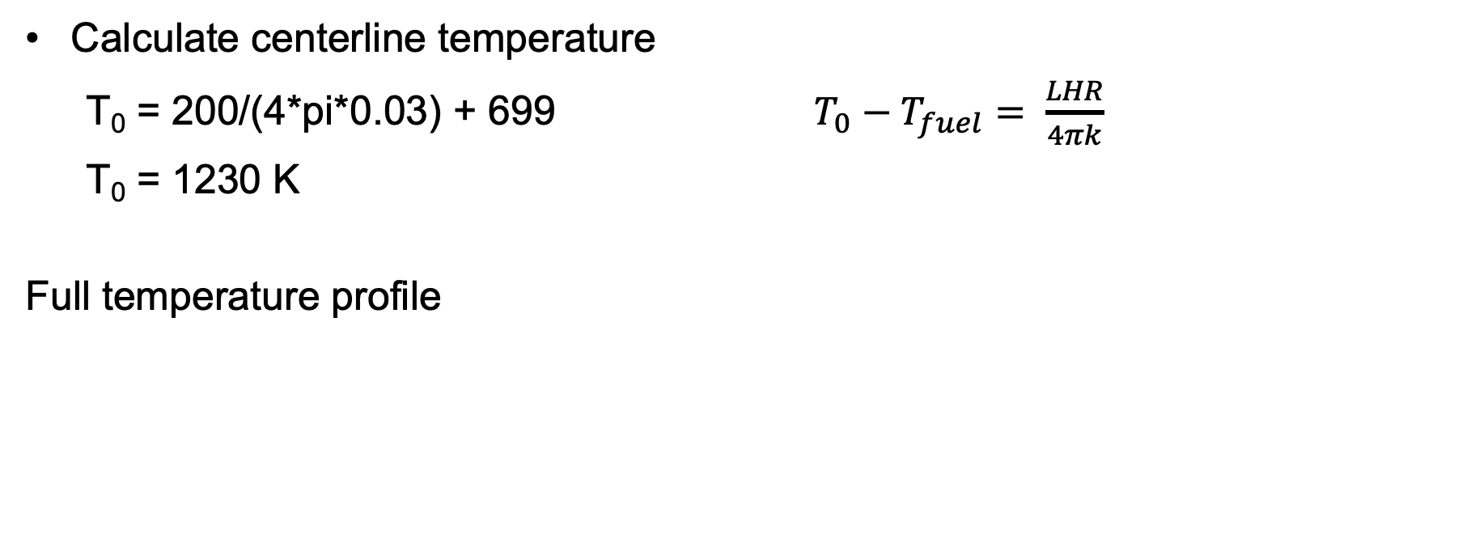
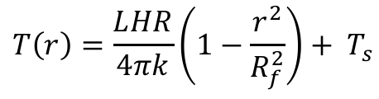
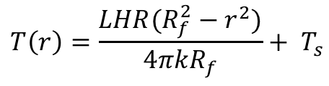
Temperature profile calculation example
Calculate centerline temperature
T₀ = 200/(4*pi*0.03) + 699 $T_{0}−T_{fuel}= \frac{LHR}{4πk}$
T₀ = 1230 K
Full temperature profile
$$T\left(r\right)=\frac{Q{(R}^{2}−r^{2})}{4k}+ T_{s}$$
$$T\left(r\right)=\frac{LHR(R_{f}^{2}−r^{2})}{4πkR_{f}}+ T_{s}$$
$$T\left(r\right)=\frac{LHR}{4πk}\left(1−\frac{r^{2}}{R_{f}^{2}}\right)+ T_{s}$$

Slide 33
Temperature profile calculation example
Parabolic temperature profile in fuel
Linear in gap and clad
Steep temperature drop over gap, very low thermal conductivity
Smaller temperature drop over cladding

Slide 34
Temperature profile modification
Instead of pure He gap, 30% of gas is Xe; how is T₀ affected?
First, how is gap conductance affected?
Gap conductance depends on the gas filling the gap
For pure He, k_{gap}=16x10⁻⁶ * T^{0.79} (W/cm-K)
For pure Xe, k_{gap}=0.7x10⁻⁶ * T^{0.79} (W/cm-K)
Simple mixing rule: k_{gap} = k_{He}(1-y) + k_{Xe}y
T_{CI}, T_{CO}, and T_{cool} is unchanged from previous example, also T₀-T_{fuel} is unchanged
k_{gap} = ((16x10⁻⁶)*(626)^{0.79} )(1-0.3) + ((0.7x10⁻⁶)*(626)^{0.79} )(0.3) = 1.85E-3 W/cm-K

Slide 35
Temperature profile modification
k_{gap} = 1.85E-3 W/cm-K
h_{gap} = 1.85E-3 / 0.003 = 0.62 W/cm²-K
T_{fuel} = 200/(2*pi*0.5*0.62) + 626 = 729 K
T₀ – T_{fuel} = 530.5 K (unchanged from before)
T₀ = 729 + 530.5 = 1259.5 K
Increase in T₀ of 30 K
Caveat: linear mixing of gases is not the best approach

Slide 36
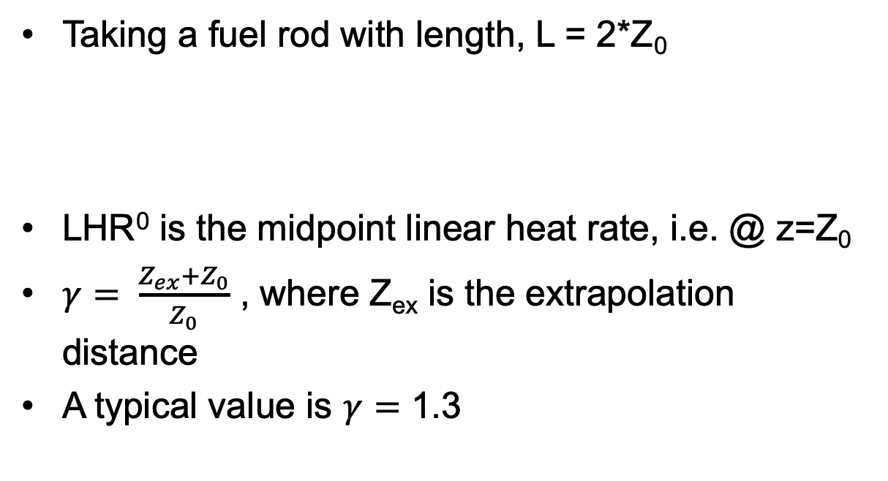
Neutron flux varies axially, so does LHR
Taking a fuel rod with length, L = 2*Z₀
LHR⁰ is the midpoint linear heat rate, i.e. @ z=Z₀
$γ= \frac{Z_{ex}+Z_{0}}{Z_{0}}$ , where Z_{ex} is the extrapolation distance
A typical value is $γ=$ 1.3

Slide 37
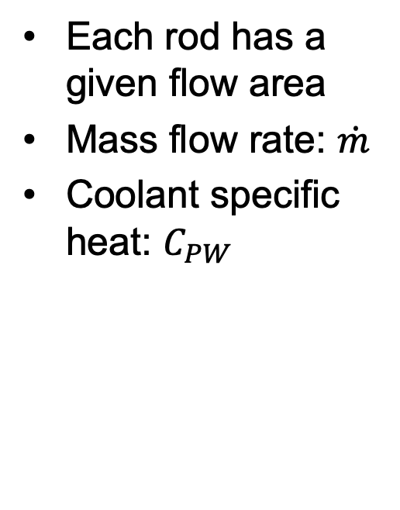
Coolant temperature varies with Z
Each rod has a given flow area
Mass flow rate: $\dot{m}$
Coolant specific heat: $C_{PW}$

Slide 38
Calculate LHR and T_{cool} with axial variation
mdot = 0.25 kg/s-rod; Z₀ = 150 cm; LHR⁰ = 150 W/cm; C_{PW} = 4200 J/kg-K; T_{in}= 570 K

Slide 39
Summary
Developed analytical expressions for the temperature profile within a fuel rod
Required to make four assumptions:
Steady-state solution
Temperature is axisymmetric
T is constant in Z
Thermal conductivity is independent of temperature
Temperature profile in the fuel is parabolic, assume linear profiles in gap, clad and coolant
Can incorporate axial variation in T_{cool} with axial variation in LHR

